Slide 1
CAMPAIGN REPORT
Campaign Performance Overview
A comprehensive look at revenue, ROI, channel performance, and geographic contribution across the campaign period — with strategic recommendations for scaling results.

Slide 2
KEY METRICS
Campaign at a Glance
2M
575K
2.84
6750
Total Revenue
Total Cost
Overall ROI
Total Conversions

Slide 3
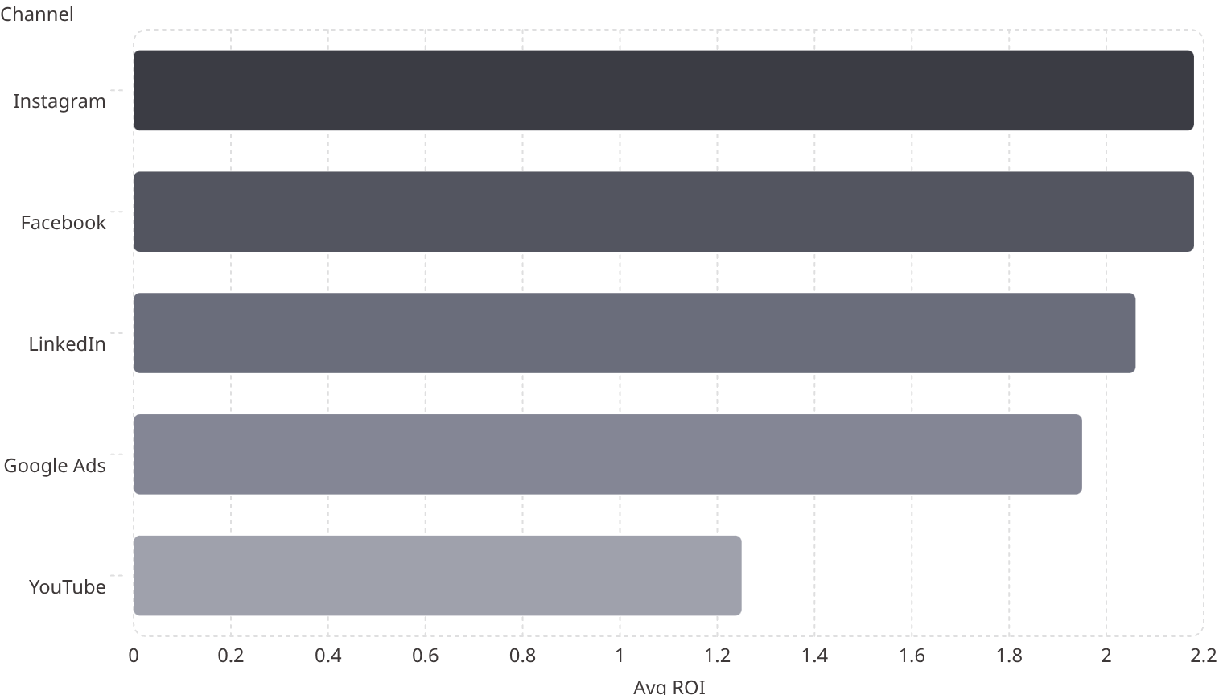
CHANNEL ANALYSIS
ROI by Channel
Channel Performance Summary
Instagram and Facebook lead with the highest ROI at 2.18. YouTube underperforms at 1.25, signaling room for optimization or budget reallocation.

Slide 4
CHANNEL ANALYSIS
Channel Performance Breakdown
Channel
Avg CTR
Conv. Rate
Avg ROI
Facebook
0.06
0.09
2.18
Google Ads
0.06
0.09
1.95
Instagram
0.06
0.09
2.20
LinkedIn
0.04
0.13
2.06
YouTube
0.06
0.07
1.25
Total
0.06
0.09
1.92
LinkedIn stands out with the highest conversion rate (0.13) despite lower CTR — a strong intent-driven channel. YouTube has the lowest conversion rate (0.07) and ROI (1.25).

Slide 5
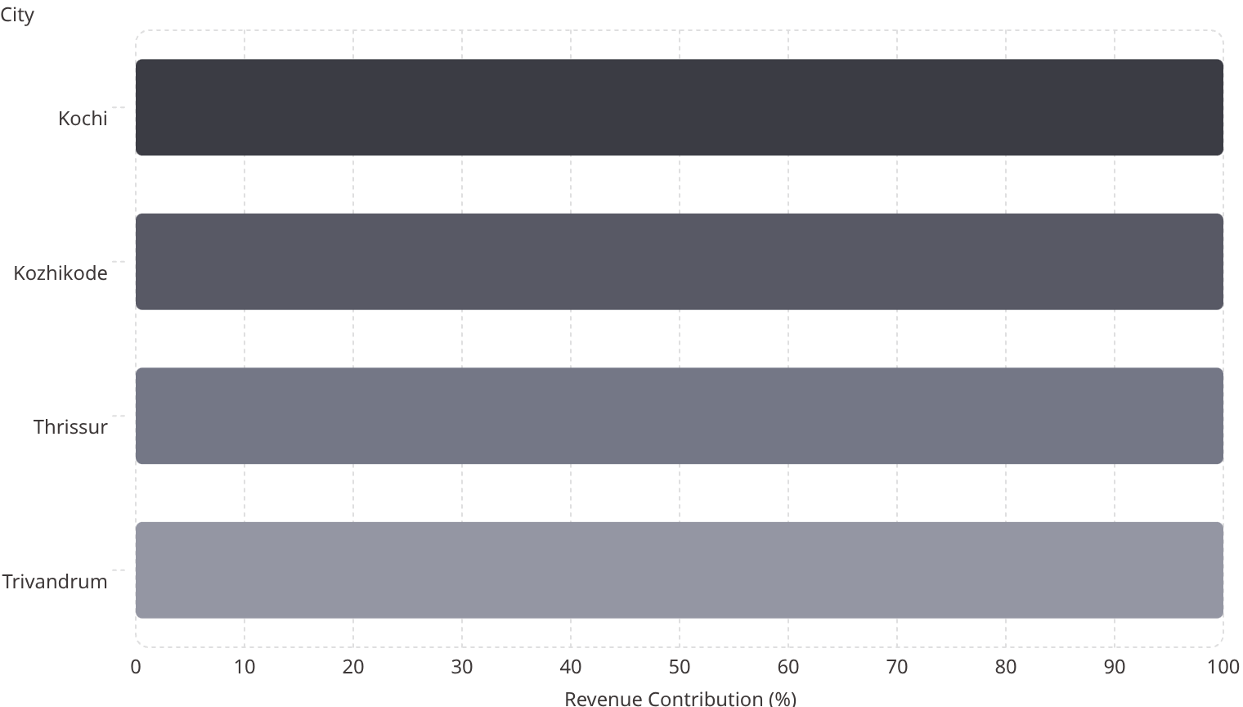

GEOGRAPHIC PERFORMANCE
City-wise Revenue Contribution
Geographic Highlights
All four cities — Kochi, Kozhikode, Thrissur, and Trivandrum — show strong revenue contribution. Kochi leads as the highest-revenue city and should be the primary geo-targeting focus.
Kochi contributes the highest revenue across all channels and time periods.

Slide 6
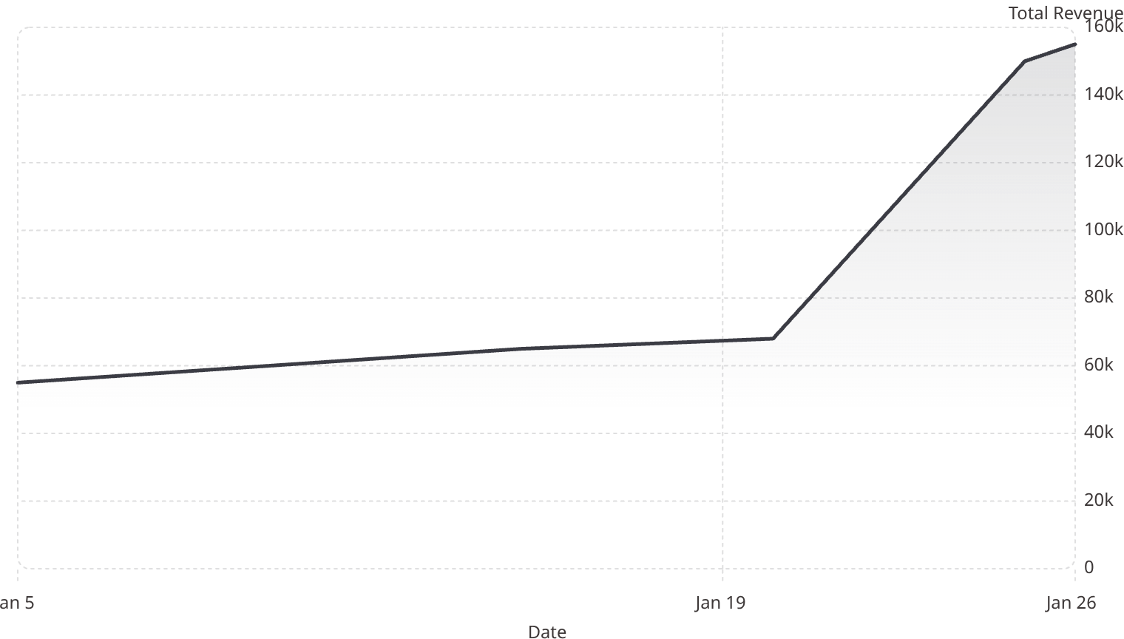
TREND ANALYSIS
Revenue Over Time
Key Observation
Revenue remained stable between 50K–70K through most of January, then spiked sharply to over 150K by month-end — confirming the effectiveness of month-end campaign pushes.

Slide 7
INSIGHTS
Key Insights
Google Ads — Consistent ROI
Instagram — High Engagement, Moderate Conversion
Google Ads shows the most consistent ROI across the campaign period, making it a reliable channel for sustained investment.
Strong engagement signals on Instagram are not fully converting — the funnel needs optimization to close the gap.
Kochi — Top Revenue City
Month-End Spike — Campaign Push Works
Kochi outperforms all other cities in revenue contribution, validating focused geo-targeting in this region.
The sharp revenue surge at month-end confirms that concentrated campaign pushes drive measurable results.

Slide 8

STRATEGY
Strategic Recommendations
Increase Budget on Google Ads
Optimize Instagram Funnel
Scale spend on the highest-consistency ROI channel to maximize returns.
Improve conversion path to capitalize on Instagram's high engagement rates.
Focus Geo-Targeting on Kochi
Plan Month-End Campaigns
Concentrate budget and creative efforts on Kochi as the top-performing city.
Align major campaign pushes with month-end timing to replicate the revenue spike.

